Slide 1

Steady-State and Transient Heat Transfer problems in C++ framework
Mech587 Project #1
Xiaoyu Mao
Oct. 3, 2022
Notes:
Good morning, Prof Carl, James and Jasmin. Today I will give you a update on my proposal titled a unified Eulerian Variational Framework for multiphase FSI. The focus of this talk will be how to unify the description of the solid and fluid in a fully Eulerian frame of reference, and how to handle the interface in a fixed mesh.

Slide 2

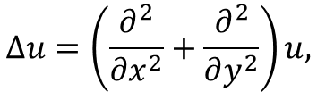
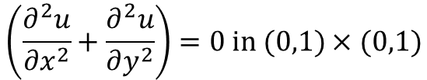

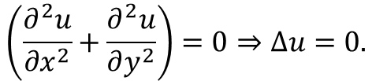


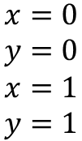

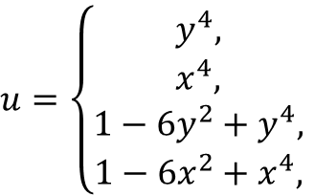

Steady-State heat transfer problem: Definition
Governing equation and boundary conditions
$$\left(\frac{∂^{2}u}{∂x^{2}}+\frac{∂^{2}u}{∂y^{2}}\right)=0 in (0,1)×(0,1)$$
$$u=1−6x^{2}+x^{4}$$
$$u=\left\{\begin{aligned}y^{4}, \\ x^{4}, \\ 1−6y^{2}+y^{4}, \\ 1−6x^{2}+x^{4},\end{aligned}\right.$$
$$\begin{matrix}x=0 \\ y=0 \\ \begin{aligned}x=1 \\ y=1\end{aligned}\end{matrix}$$
$$\frac{∂^{2}u}{∂x^{2}}+\frac{∂^{2}u}{∂y^{2}} =0$$
$$u=y^{4}$$
$$u=1−6y^{2}+y^{4}$$
on
The problem has the following exact solution:
$$u=x^{4}$$
$$u\left(x,y\right)=x^{4}+y^{4}−6x^{2}y^{2}$$
To simplify the notation, we denote:
$$Δu=\left(\frac{∂^{2}}{∂x^{2}}+\frac{∂^{2}}{∂y^{2}}\right)u,$$
$$\left(\frac{∂^{2}u}{∂x^{2}}+\frac{∂^{2}u}{∂y^{2}}\right)=0⇒Δu=0.$$
Notes:
First, let me introduce the context of my research topic. The current research topic is motivated by the intelligent and green marine vessel proposal. We focus on the development of tools which make the marine vessels intelligent and environmentally friendly. Combining the high-fidelity model-based simulation and data driven techniques, we want to make the design and operation of the next generation marine vessels more interactive, automized, efficient and green. My focus is to reduce the noise of the ship and its harm to the marine mammals. This requires high fidelity simulation of multiphase fluid structure interaction.

Slide 3

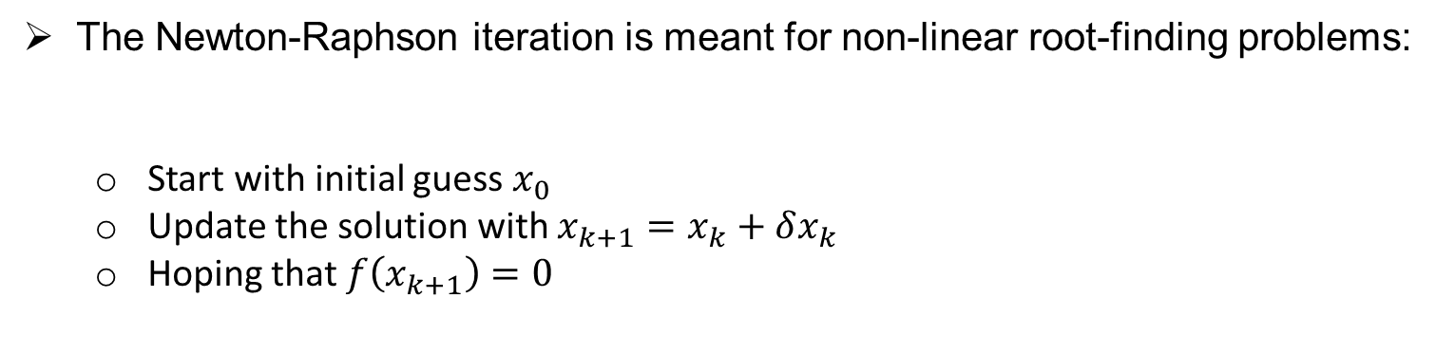
Newton-Raphson iteration (1)
The Newton-Raphson iteration is meant for non-linear root-finding problems:
Start with initial guess $x_{0}$
Update the solution with $x_{k+1}=x_{k}+δx_{k}$
Hoping that $f\left(x_{k+1}\right)=0$
$f\left(x\right)=ax^{5}+be^{x}+csin(x)$, solve $f\left(x\right)=0$
How to solve the increment $δx_{k}$ ?
Write in increment form:
Taylor Expansion:
Solve the increment:
Update solution: $x_{k+1}=x_{k}+δx_{k}$
$$f\left(x_{k+1}\right)=0⇒f\left(x_{k}+δx_{k}\right)=0$$
$$f\left(x_{k}\right)+f^{′}\left(x_{k}\right)δx_{k}=0$$
$$f^{′}\left(x_{k}\right)δx_{k}=−f\left(x_{k}\right)$$

Slide 4
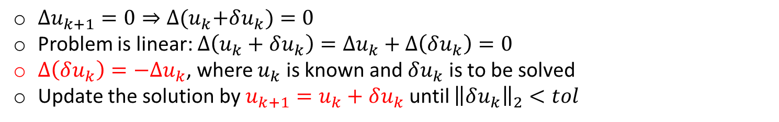


Newton-Raphson iteration (2)
The Newton-Raphson method solve the problem in an iterative manner:
We start with an initial guess $u_{0}$
We update the guess with increment $u_{1}=u_{0}+δu_{0}$
Keep updating the solution $u_{k+1}=u_{k}+δu_{k}$
With the hope that $Δu_{k+1}=0$
How to get $δu_{k}$ and update the solution?
$Δu_{k+1}=0⇒Δ{(u}_{k}+δu_{k})=0$
Problem is linear: $Δ\left(u_{k}+δu_{k}\right)=Δu_{k}+Δ\left(δu_{k}\right)=0$
$Δ\left(δu_{k}\right)=−Δu_{k}$, where $u_{k}$ is known and $δu_{k}$ is to be solved
Update the solution by $u_{k+1}=u_{k}+δu_{k}$ until ${\left\|δu_{k}\right\|}_{2}<tol$
Note: The necessity of this method will be straight forward later when we handling the non-linear convection terms. We use it for linear problem here only for learning purpose.

Slide 5
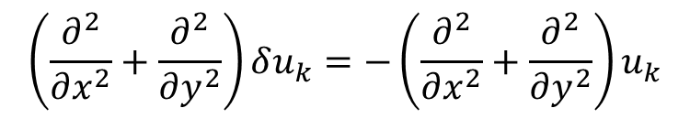
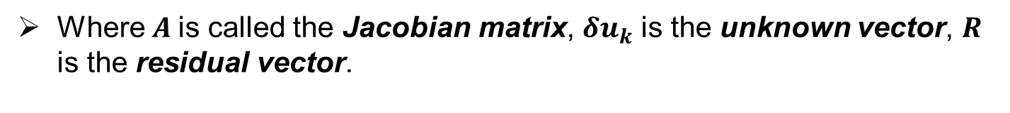

Matrix form with central difference method (1)
Now we just need to solve:
$$Δ\left(δu_{k}\right)=−Δu_{k}$$
For true solution, $Δu=0$. Since $u_{k}≠u$, $Δu_{k}$ is a non-zero vector. We call $Δu_{k}$ as the Residual
$$\left(\frac{∂^{2}}{∂x^{2}}+\frac{∂^{2}}{∂y^{2}}\right)δu_{k}=−\left(\frac{∂^{2}}{∂x^{2}}+\frac{∂^{2}}{∂y^{2}}\right)u_{k}$$
After discretization, the matrix form becomes:
$$Aδu_{k}=−R$$
Where $A$is called the Jacobian matrix, $δu_{k}$ is the unknown vector, $R$ is the residual vector.
Your task in this project is to construct $A$ and $R$ to solve for $δu_{k}$

Slide 6









Central difference approximation
Remove subscript $k$ considering all the vectors are at $k$ iteration:
$$Δ\left(δu_{k}\right)=−Δu_{k}⇒\left(\frac{∂^{2}}{∂x^{2}}+\frac{∂^{2}}{∂y^{2}}\right)δu=−\left(\frac{∂^{2}}{∂x^{2}}+\frac{∂^{2}}{∂y^{2}}\right)u$$
To approximate the Laplacian operator $Δ$:
$$N_{i,j+1}$$
Consider the central difference stencil:
At Node $N_{i,j}$
Adding them up, the LHS of the equation can be discretized as:
Similarly, the RHS of the equation can be discretized as
$${\left(\frac{∂^{2}}{∂x^{2}}δu\right)}_{i,j}⇒\frac{{δu}_{i−1,j}−2{δu}_{i,j}+{δu}_{i+1,j}}{Δx^{2}}$$
$$N_{i−1,j}$$
$$N_{i+1,j}$$
$$N_{i,j}$$
$${\left(\frac{∂^{2}}{∂y^{2}}δu\right)}_{i,j}⇒\frac{δu_{i,j−1}−2δu_{i,j}+{δu}_{i,j+1}}{Δy^{2}}$$
$$N_{i,j−1}$$
$${\left(\frac{∂^{2}}{∂x^{2}}+\frac{∂^{2}}{∂y^{2}}\right)}_{i,j}δu=\frac{1}{Δx^{2}}δu_{i−1,j}+\frac{1}{Δy^{2}}δu_{i,j−1}+\left(−\frac{2}{Δx^{2}}−\frac{2}{Δy^{2}}\right)δu_{i,j}+\frac{1}{Δy^{2}}δu_{i,j+1}+\frac{1}{Δx^{2}}δu_{i+1,j}$$
$${\left(\frac{∂^{2}}{∂x^{2}}+\frac{∂^{2}}{∂y^{2}}\right)}_{i,j}u=\frac{u_{i−1,j}−2u_{i,j}+u_{i+1,j}}{Δx^{2}}+\frac{u_{i,j−1}−2u_{i,j}+u_{i,j+1}}{Δy^{2}}$$

Slide 7



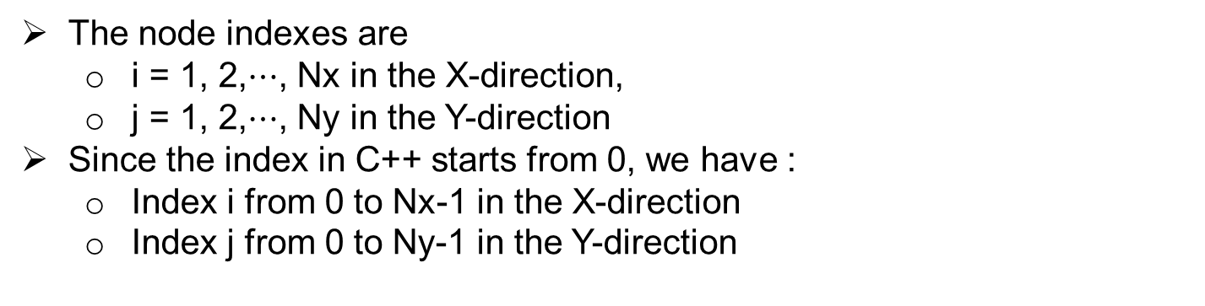






Index of the mesh nodes
The node indexes are
i = 1, 2,$⋯$, Nx in the X-direction,
j = 1, 2,$⋯$, Ny in the Y-direction
Since the index in C++ starts from 0, we have :
Index i from 0 to Nx-1 in the X-direction
Index j from 0 to Ny-1 in the Y-direction
$$N_{0,Ny−1}$$
$$N_{i,Ny−1}$$
$$N_{Nx−1,Ny−1}$$
$$N_{0,j}$$
$$N_{i,j}$$
$$N_{Nx−1,j}$$
$$N_{0,0}$$
$$N_{i,0}$$
$$N_{Nx−1,0}$$

Slide 8










Equation for interior node
Remove subscript $k$ considering all the vectors are at $k$ iteration:
$$Δ\left(δu_{k}\right)=−Δu_{k}⇒\left(\frac{∂^{2}}{∂x^{2}}+\frac{∂^{2}}{∂y^{2}}\right)δu=−\left(\frac{∂^{2}}{∂x^{2}}+\frac{∂^{2}}{∂y^{2}}\right)u$$
$$N_{0,2}$$
$$N_{1,2}$$
$$N_{2,2}$$
Let’s consider the simplest possible mesh at the RHS:
with only one interior node: $N_{1,1}$, where we need to solve the PDE
$$N_{0,1}$$
$$N_{1,1}$$
$$N_{2,1}$$
With central difference method, the LHS of the PDE at Node $N_{1,1}$ can be approximated as:
$$N_{0,0}$$
$$N_{1,0}$$
$$N_{2,0}$$
$${\left(\left(\frac{∂^{2}}{∂x^{2}}+\frac{∂^{2}}{∂y^{2}}\right)δu\right)}_{1,1}=\frac{1}{Δx^{2}}δu_{0,1}+\frac{1}{Δy^{2}}δu_{1,0}+\left(−\frac{2}{Δx^{2}}−\frac{2}{Δy^{2}}\right)δu_{1,1}+\frac{1}{Δy^{2}}δu_{1,2}+\frac{1}{Δx^{2}}δu_{2,1}$$
With central difference method, the RHS of the PDE at Node $N_{1,1}$ can be approximated as:
$$−{\left(\left(\frac{∂^{2}}{∂x^{2}}+\frac{∂^{2}}{∂y^{2}}\right)u\right)}_{1,1}=−\left(\frac{u_{0,1}−2u_{1,1}+u_{2,1}}{Δx^{2}}+\frac{u_{1,0}−2u_{1,1}+u_{1,2}}{Δy^{2}}\right)$$
Therefore, the PDE at $N_{1,1}$ can be discretized as:
$$\frac{1}{Δx^{2}}δu_{0,1}+\frac{1}{Δy^{2}}δu_{1,0}+\left(−\frac{2}{Δx^{2}}−\frac{2}{Δy^{2}}\right)δu_{1,1}+\frac{1}{Δy^{2}}δu_{1,2}+\frac{1}{Δx^{2}}δu_{2,1}$$

Slide 9



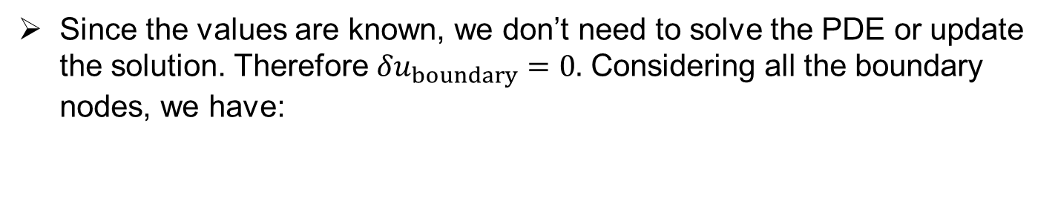








Equations for boundary nodes
Only Dirichlet boundary conditions are specified in this problem, which means that the function value at boundary nodes are directly given.
Boundary conditions needs to be enforced at every time step as:
$$u_{boundary}=f(x,y,t)$$
Since the values are known, we don’t need to solve the PDE or update the solution. Therefore ${δu}_{boundary}=0.$ Considering all the boundary nodes, we have:
$${δu}_{0,0}=0$$
$${δu}_{0,1}=0$$
$${δu}_{0,2}=0$$
$${δu}_{1,0}=0$$
$${δu}_{1,2}=0$$
$${δu}_{2,0}=0$$
$${δu}_{2,1}=0$$
$${δu}_{2,2}=0$$
$$N_{0,2}$$
$$N_{1,2}$$
$$N_{2,2}$$
$$N_{0,1}$$
$$N_{1,1}$$
$$N_{2,1}$$
$$N_{0,0}$$
$$N_{1,0}$$
$$N_{2,0}$$

Slide 10

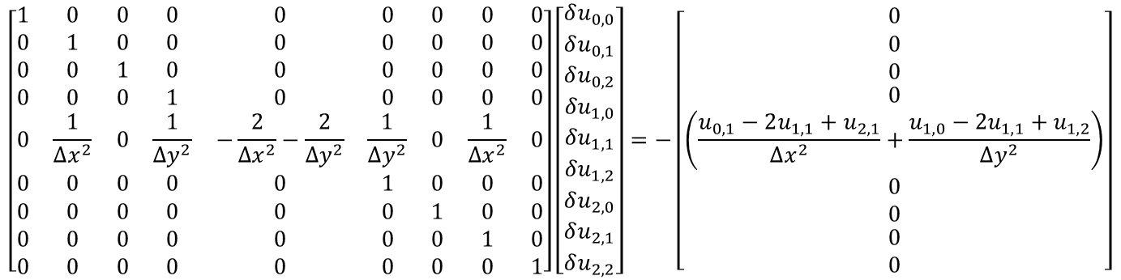






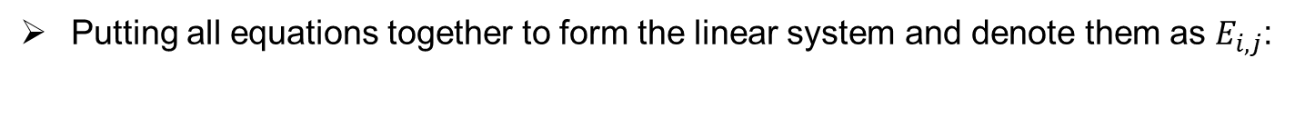

Matrix form of the problem:
Putting all equations together to form the linear system and denote them as $E_{i,j}$:
$$\left\{\begin{aligned}δu_{0,0}=\text{0} \\ δu_{0,1}=\text{0} \\ \begin{matrix}δu_{0,2}=\text{0} \\ δu_{1,0}=\text{0} \\ \begin{matrix}\begin{aligned}\frac{1}{Δx^{2}}δu_{0,1}+\frac{1}{Δy^{2}}δu_{1,0}+\left(−\frac{2}{Δx^{2}}−\frac{2}{Δy^{2}}\right)δu_{1,1}+\frac{1}{Δy^{2}}δu_{1,2}+\frac{1}{Δx^{2}}δu_{2,1}= \\ −\left(\frac{u_{0,1}−2u_{1,1}+u_{2,1}}{Δx^{2}}+\frac{u_{1,0}−2u_{1,1}+u_{1,2}}{Δy^{2}}\right)\end{aligned} \\ δu_{1,2}=\text{0} \\ \begin{matrix}δu_{2,0}=\text{0} \\ δu_{2,1}=\text{0} \\ δu_{2,2}=\text{0}\end{matrix}\end{matrix}\end{matrix}\end{aligned}\right.$$
$$\begin{matrix}(E_{0,0}) \\ (E_{0,1}) \\ \begin{matrix}\left(E_{0,2}\right) \\ \left(E_{1,0}\right) \end{matrix}\end{matrix}$$
$$(E_{1,1})$$
$$\begin{matrix}\left(E_{1,2}\right) \\ \begin{matrix}\left(E_{2,0}\right) \\ \left(E_{2,1}\right) \\ \left(E_{2,2}\right) \end{matrix}\end{matrix}$$
Matrix form:
$$\left[\begin{matrix}1 & 0 & 0 & 0 & 0 & 0 & 0 & 0 & 0 \\ 0 & 1 & 0 & 0 & 0 & 0 & 0 & 0 & 0 \\ 0 & 0 & 1 & 0 & 0 & 0 & 0 & 0 & 0 \\ 0 & 0 & 0 & 1 & 0 & 0 & 0 & 0 & 0 \\ 0 & \frac{1}{Δx^{2}} & 0 & \frac{1}{Δy^{2}} & −\frac{2}{Δx^{2}}−\frac{2}{Δy^{2}} & \frac{1}{Δy^{2}} & 0 & \frac{1}{Δx^{2}} & 0 \\ 0 & 0 & 0 & 0 & 0 & 1 & 0 & 0 & 0 \\ 0 & 0 & 0 & 0 & 0 & 0 & 1 & 0 & 0 \\ 0 & 0 & 0 & 0 & 0 & 0 & 0 & 1 & 0 \\ 0 & 0 & 0 & 0 & 0 & 0 & 0 & 0 & 1\end{matrix}\right]\left[\begin{matrix}\begin{matrix}\begin{matrix}\begin{matrix}δu_{0,0} \\ δu_{0,1} \\ δu_{0,2}\end{matrix} \\ δu_{1,0} \\ δu_{1,1}\end{matrix} \\ δu_{1,2} \\ δu_{2,0}\end{matrix} \\ δu_{2,1} \\ δu_{2,2}\end{matrix}\right]=−\left[\begin{matrix}\begin{matrix}\begin{matrix}\begin{matrix}0 \\ 0 \\ 0\end{matrix} \\ 0 \\ \left(\frac{u_{0,1}−2u_{1,1}+u_{2,1}}{Δx^{2}}+\frac{u_{1,0}−2u_{1,1}+u_{1,2}}{Δy^{2}}\right)\end{matrix} \\ 0 \\ 0\end{matrix} \\ 0 \\ 0\end{matrix}\right]$$
$$\begin{matrix}(E_{0,0}) \\ (E_{0,1}) \\ \begin{matrix}\left(E_{0,2}\right) \\ \left(E_{1,0}\right) \end{matrix}\end{matrix}$$
$$(E_{1,1})$$
$$\begin{matrix}\left(E_{1,2}\right) \\ \begin{matrix}\left(E_{2,0}\right) \\ \left(E_{2,1}\right) \\ \left(E_{2,2}\right) \end{matrix}\end{matrix}$$
Unknown vector $δu_{k}$
Jacobian matrix $A$
Residual vector $−R$

Slide 11
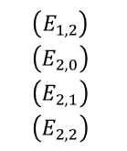
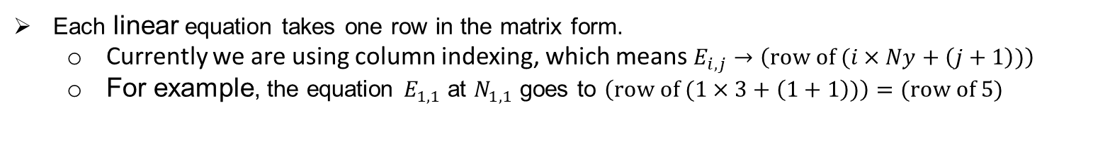
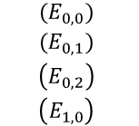
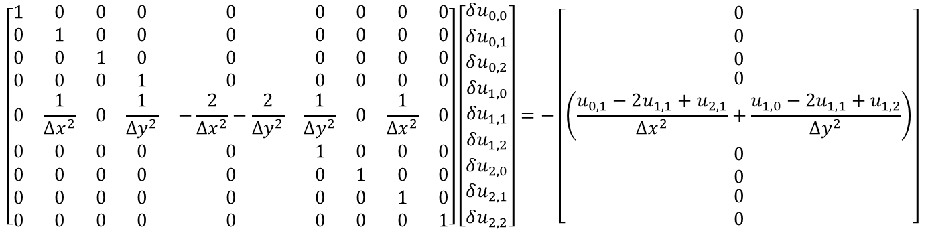




Denotation for sparse matrix (2)
Matrix form
$$\left[\begin{matrix}1 & 0 & 0 & 0 & 0 & 0 & 0 & 0 & 0 \\ 0 & 1 & 0 & 0 & 0 & 0 & 0 & 0 & 0 \\ 0 & 0 & 1 & 0 & 0 & 0 & 0 & 0 & 0 \\ 0 & 0 & 0 & 1 & 0 & 0 & 0 & 0 & 0 \\ 0 & \frac{1}{Δx^{2}} & 0 & \frac{1}{Δy^{2}} & −\frac{2}{Δx^{2}}−\frac{2}{Δy^{2}} & \frac{1}{Δy^{2}} & 0 & \frac{1}{Δx^{2}} & 0 \\ 0 & 0 & 0 & 0 & 0 & 1 & 0 & 0 & 0 \\ 0 & 0 & 0 & 0 & 0 & 0 & 1 & 0 & 0 \\ 0 & 0 & 0 & 0 & 0 & 0 & 0 & 1 & 0 \\ 0 & 0 & 0 & 0 & 0 & 0 & 0 & 0 & 1\end{matrix}\right]\left[\begin{matrix}\begin{matrix}\begin{matrix}\begin{matrix}δu_{0,0} \\ δu_{0,1} \\ δu_{0,2}\end{matrix} \\ δu_{1,0} \\ δu_{1,1}\end{matrix} \\ δu_{1,2} \\ δu_{2,0}\end{matrix} \\ δu_{2,1} \\ δu_{2,2}\end{matrix}\right]=−\left[\begin{matrix}\begin{matrix}\begin{matrix}\begin{matrix}0 \\ 0 \\ 0\end{matrix} \\ 0 \\ \left(\frac{u_{0,1}−2u_{1,1}+u_{2,1}}{Δx^{2}}+\frac{u_{1,0}−2u_{1,1}+u_{1,2}}{Δy^{2}}\right)\end{matrix} \\ 0 \\ 0\end{matrix} \\ 0 \\ 0\end{matrix}\right]$$
$$\begin{matrix}(E_{0,0}) \\ (E_{0,1}) \\ \begin{matrix}\left(E_{0,2}\right) \\ \left(E_{1,0}\right) \end{matrix}\end{matrix}$$
$$(E_{1,1})$$
$$\begin{matrix}\left(E_{1,2}\right) \\ \begin{matrix}\left(E_{2,0}\right) \\ \left(E_{2,1}\right) \\ \left(E_{2,2}\right) \end{matrix}\end{matrix}$$
Unknown vector $δu$
Jacobian matrix $A$
Residual vector $−R$
To save memory, we don’t want to store zeros. Therefore, we need to come up with projection from the node indexing to the position of the matrices and vectors for all the coefficients.
Each linear equation takes one row in the matrix form.
Currently we are using column indexing, which means $E_{i,j}→\left(row of (i×Ny+\left(j+1\right))\right)$
For example, the equation $E_{1,1}$ at $N_{1,1}$ goes to $\left(row of (1×3+\left(1+1\right))\right)=(row of 5)$

Slide 12


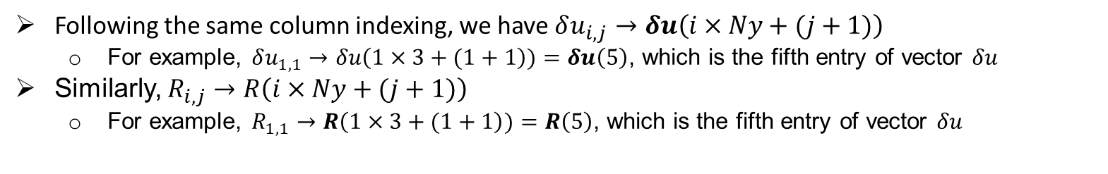


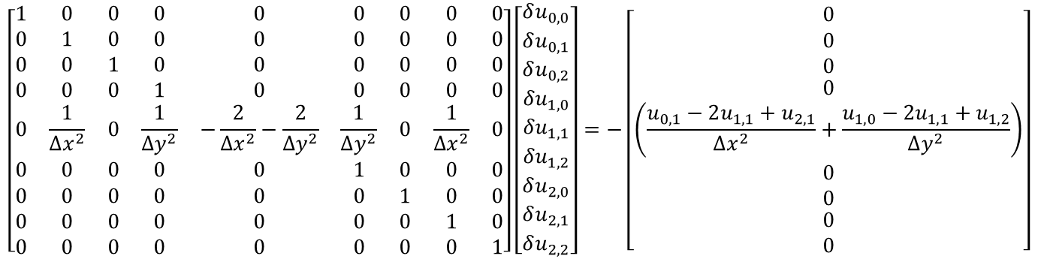








Denotation of sparse matrix (1)
We notice that there are lots of zeros in the Jacobian matrix and residual vector:
$$\left[\begin{matrix}1 & 0 & 0 & 0 & 0 & 0 & 0 & 0 & 0 \\ 0 & 1 & 0 & 0 & 0 & 0 & 0 & 0 & 0 \\ 0 & 0 & 1 & 0 & 0 & 0 & 0 & 0 & 0 \\ 0 & 0 & 0 & 1 & 0 & 0 & 0 & 0 & 0 \\ 0 & \frac{1}{Δx^{2}} & 0 & \frac{1}{Δy^{2}} & −\frac{2}{Δx^{2}}−\frac{2}{Δy^{2}} & \frac{1}{Δy^{2}} & 0 & \frac{1}{Δx^{2}} & 0 \\ 0 & 0 & 0 & 0 & 0 & 1 & 0 & 0 & 0 \\ 0 & 0 & 0 & 0 & 0 & 0 & 1 & 0 & 0 \\ 0 & 0 & 0 & 0 & 0 & 0 & 0 & 1 & 0 \\ 0 & 0 & 0 & 0 & 0 & 0 & 0 & 0 & 1\end{matrix}\right]\left[\begin{matrix}\begin{matrix}\begin{matrix}\begin{matrix}δu_{0,0} \\ δu_{0,1} \\ δu_{0,2}\end{matrix} \\ δu_{1,0} \\ δu_{1,1}\end{matrix} \\ δu_{1,2} \\ δu_{2,0}\end{matrix} \\ δu_{2,1} \\ δu_{2,2}\end{matrix}\right]=−\left[\begin{matrix}\begin{matrix}\begin{matrix}\begin{matrix}0 \\ 0 \\ 0\end{matrix} \\ 0 \\ \left(\frac{u_{0,1}−2u_{1,1}+u_{2,1}}{Δx^{2}}+\frac{u_{1,0}−2u_{1,1}+u_{1,2}}{Δy^{2}}\right)\end{matrix} \\ 0 \\ 0\end{matrix} \\ 0 \\ 0\end{matrix}\right]$$
Unknown vector $δu$
Jacobian matrix $A$
Residual vector $−R$
Following the same column indexing, we have $δu_{i,j}→δu\left(i×Ny+(j+1)\right)$
For example, $δu_{1,1}→δu\left(1×3+(1+1\right))=δu\left(5\right)$, which is the fifth entry of vector $δu$
Similarly, $R_{i,j}→R\left(i×Ny+(j+1)\right)$
For example, $R_{1,1}→R\left(1×3+(1+1\right))=R\left(5\right)$, which is the fifth entry of vector $δu$
$$N_{0,2}$$
$$N_{1,2}$$
$$N_{2,2}$$
$$N_{0,1}$$
$$N_{1,1}$$
$$N_{2,1}$$
$$N_{0,0}$$
$$N_{1,0}$$
$$N_{2,0}$$

Slide 13
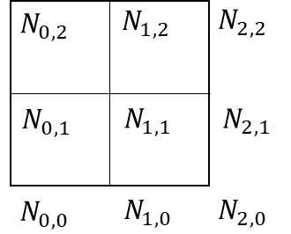
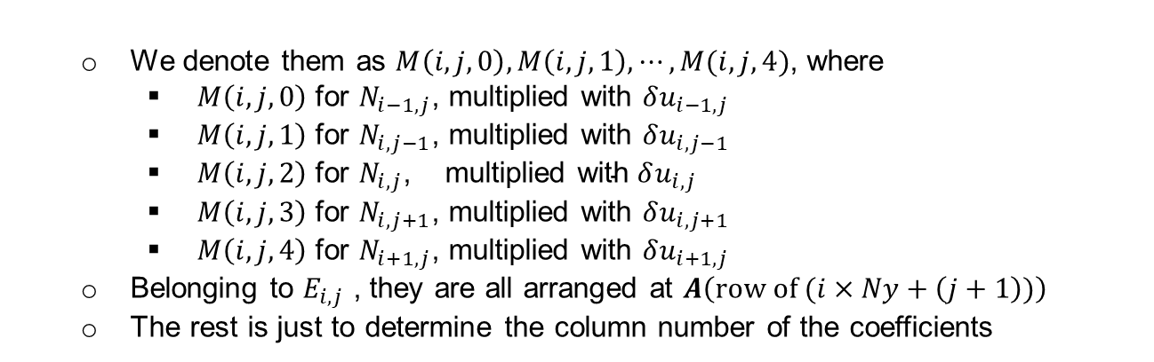







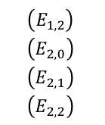


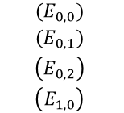

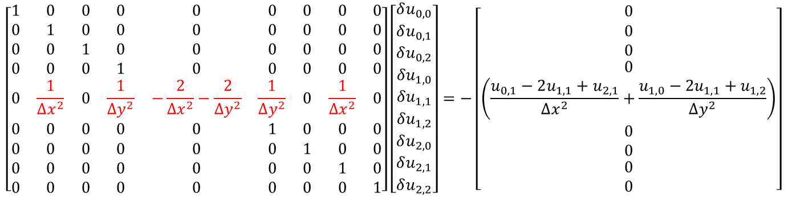

Denotation for sparse matrix (3)
We have five coefficients for the central difference stencil in $E_{i,j}$
when $N_{i,j}$ is an interior node. Considering $E_{1,1}$ as an example:
$$\left[\begin{matrix}1 & 0 & 0 & 0 & 0 & 0 & 0 & 0 & 0 \\ 0 & 1 & 0 & 0 & 0 & 0 & 0 & 0 & 0 \\ 0 & 0 & 1 & 0 & 0 & 0 & 0 & 0 & 0 \\ 0 & 0 & 0 & 1 & 0 & 0 & 0 & 0 & 0 \\ 0 & \frac{1}{Δx^{2}} & 0 & \frac{1}{Δy^{2}} & −\frac{2}{Δx^{2}}−\frac{2}{Δy^{2}} & \frac{1}{Δy^{2}} & 0 & \frac{1}{Δx^{2}} & 0 \\ 0 & 0 & 0 & 0 & 0 & 1 & 0 & 0 & 0 \\ 0 & 0 & 0 & 0 & 0 & 0 & 1 & 0 & 0 \\ 0 & 0 & 0 & 0 & 0 & 0 & 0 & 1 & 0 \\ 0 & 0 & 0 & 0 & 0 & 0 & 0 & 0 & 1\end{matrix}\right]\left[\begin{matrix}\begin{matrix}\begin{matrix}\begin{matrix}δu_{0,0} \\ δu_{0,1} \\ δu_{0,2}\end{matrix} \\ δu_{1,0} \\ δu_{1,1}\end{matrix} \\ δu_{1,2} \\ δu_{2,0}\end{matrix} \\ δu_{2,1} \\ δu_{2,2}\end{matrix}\right]=−\left[\begin{matrix}\begin{matrix}\begin{matrix}\begin{matrix}0 \\ 0 \\ 0\end{matrix} \\ 0 \\ \left(\frac{u_{0,1}−2u_{1,1}+u_{2,1}}{Δx^{2}}+\frac{u_{1,0}−2u_{1,1}+u_{1,2}}{Δy^{2}}\right)\end{matrix} \\ 0 \\ 0\end{matrix} \\ 0 \\ 0\end{matrix}\right]$$
$$\begin{matrix}(E_{0,0}) \\ (E_{0,1}) \\ \begin{matrix}\left(E_{0,2}\right) \\ \left(E_{1,0}\right) \end{matrix}\end{matrix}$$
$$(E_{1,1})$$
$$\begin{matrix}\left(E_{1,2}\right) \\ \begin{matrix}\left(E_{2,0}\right) \\ \left(E_{2,1}\right) \\ \left(E_{2,2}\right) \end{matrix}\end{matrix}$$
The highlighted line is essentially:
$$\frac{1}{Δx^{2}}δu_{0,1}+\frac{1}{Δy^{2}}δu_{1,0}+\left(−\frac{2}{Δx^{2}}−\frac{2}{Δy^{2}}\right)δu_{1,1}+\frac{1}{Δy^{2}}δu_{1,2}+\frac{1}{Δx^{2}}δu_{2,1}$$
$$M\left(1,1,0\right)$$
We denote them as $M\left(i,j,0\right),M\left(i,j,1\right),⋯,M(i,j,4)$, where
$M\left(i,j,0\right)$ for $N_{i−1,j}$, multiplied with $δu_{i−1,j}$
$M\left(i,j,1\right)$ for $N_{i,j−1}$, multiplied with $δu_{i,j−1}$
$M\left(i,j,2\right)$ for $N_{i,j}$, multiplied $\text{with} δu_{i,j}$
$M\left(i,j,3\right)$ for $N_{i,j+1}$, multiplied with $δu_{i,j+1}$
$M\left(i,j,4\right)$ for $N_{i+1,j}$, multiplied with $δu_{i+1,j}$
Belonging to $E_{i,j}$ , they are all arranged at $A\left(row of (i×Ny+\left(j+1\right))\right)$
The rest is just to determine the column number of the coefficients
$$M\left(1,1,1\right)$$
$$M\left(1,1,2\right)$$
$$M\left(1,1,3\right)$$
$$M\left(1,1,4\right)$$
$$N_{i,j+1}$$
$$N_{i−1,j}$$
$$N_{i+1,j}$$
$$N_{i,j}$$
$$N_{i,j−1}$$

Slide 14
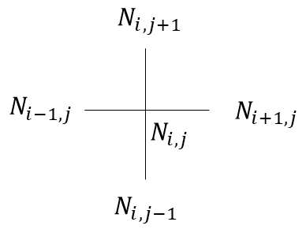

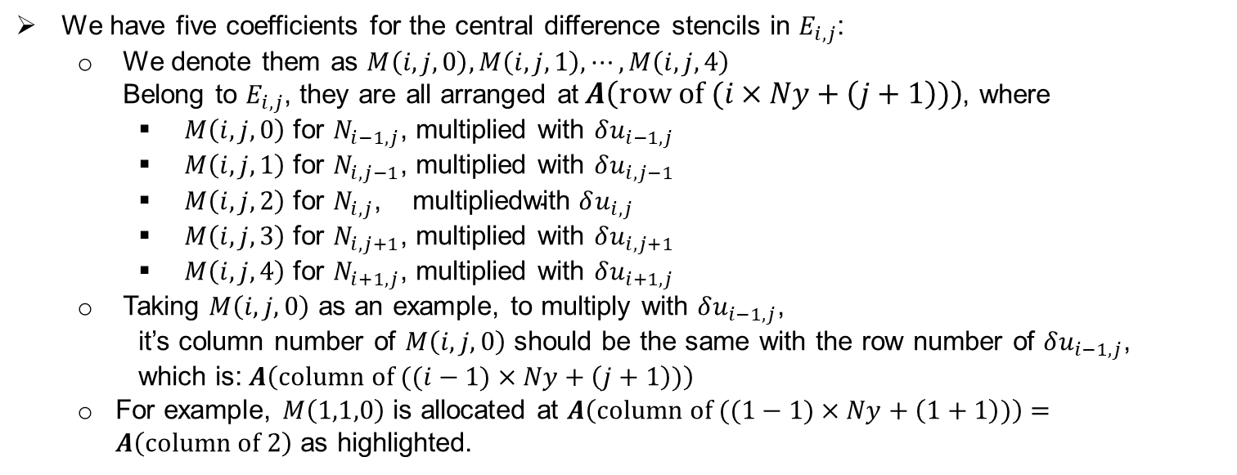
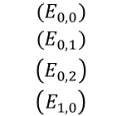
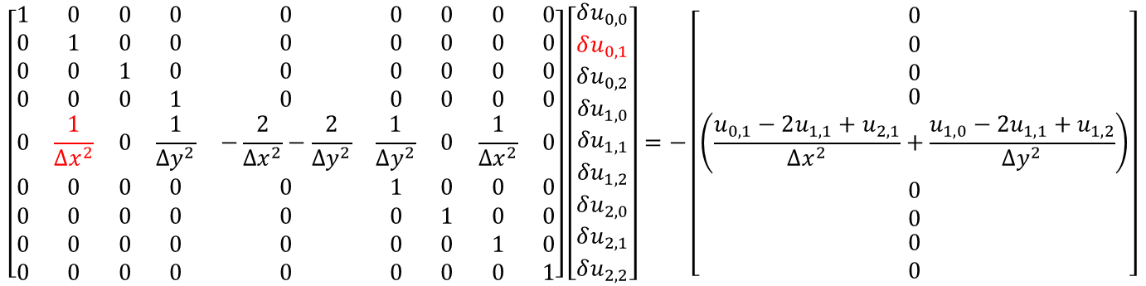



Denotation for sparse matrix (4)
Matrix form
$$\left[\begin{matrix}1 & 0 & 0 & 0 & 0 & 0 & 0 & 0 & 0 \\ 0 & 1 & 0 & 0 & 0 & 0 & 0 & 0 & 0 \\ 0 & 0 & 1 & 0 & 0 & 0 & 0 & 0 & 0 \\ 0 & 0 & 0 & 1 & 0 & 0 & 0 & 0 & 0 \\ 0 & \frac{1}{Δx^{2}} & 0 & \frac{1}{Δy^{2}} & −\frac{2}{Δx^{2}}−\frac{2}{Δy^{2}} & \frac{1}{Δy^{2}} & 0 & \frac{1}{Δx^{2}} & 0 \\ 0 & 0 & 0 & 0 & 0 & 1 & 0 & 0 & 0 \\ 0 & 0 & 0 & 0 & 0 & 0 & 1 & 0 & 0 \\ 0 & 0 & 0 & 0 & 0 & 0 & 0 & 1 & 0 \\ 0 & 0 & 0 & 0 & 0 & 0 & 0 & 0 & 1\end{matrix}\right]\left[\begin{matrix}\begin{matrix}\begin{matrix}\begin{matrix}δu_{0,0} \\ δu_{0,1} \\ δu_{0,2}\end{matrix} \\ δu_{1,0} \\ δu_{1,1}\end{matrix} \\ δu_{1,2} \\ δu_{2,0}\end{matrix} \\ δu_{2,1} \\ δu_{2,2}\end{matrix}\right]=−\left[\begin{matrix}\begin{matrix}\begin{matrix}\begin{matrix}0 \\ 0 \\ 0\end{matrix} \\ 0 \\ \left(\frac{u_{0,1}−2u_{1,1}+u_{2,1}}{Δx^{2}}+\frac{u_{1,0}−2u_{1,1}+u_{1,2}}{Δy^{2}}\right)\end{matrix} \\ 0 \\ 0\end{matrix} \\ 0 \\ 0\end{matrix}\right]$$
$$\begin{matrix}(E_{0,0}) \\ (E_{0,1}) \\ \begin{matrix}\left(E_{0,2}\right) \\ \left(E_{1,0}\right) \end{matrix}\end{matrix}$$
$$(E_{1,1})$$
$$\begin{matrix}\left(E_{1,2}\right) \\ \begin{matrix}\left(E_{2,0}\right) \\ \left(E_{2,1}\right) \\ \left(E_{2,2}\right) \end{matrix}\end{matrix}$$
Unknown vector $δu$
Residual vector $−R$
Jacobian matrix $A$
We have five coefficients for the central difference stencils in $E_{i,j}$:
We denote them as $M\left(i,j,0\right),M\left(i,j,1\right),⋯,M\left(i,j,4\right)$
Belong to $E_{i,j}$, they are all arranged at$A\left(row of (i×Ny+\left(j+1\right))\right)$, where
$M\left(i,j,0\right)$ for $N_{i−1,j}$, multiplied with $δu_{i−1,j}$
$M\left(i,j,1\right)$ for $N_{i,j−1}$, multiplied with $δu_{i,j−1}$
$M\left(i,j,2\right)$ for $N_{i,j}$, multiplied$\text{with} δu_{i,j}$
$M\left(i,j,3\right)$ for $N_{i,j+1}$, multiplied with $δu_{i,j+1}$
$M\left(i,j,4\right)$ for $N_{i+1,j}$, multiplied with $δu_{i+1,j}$
Taking $M\left(i,j,0\right)$ as an example, to multiply with $δu_{i−1,j}$,
it’s column number of $M\left(i,j,0\right)$ should be the same with the row number of $δu_{i−1,j}$,
which is: $A\left(column of ((i−1)×Ny+\left(j+1\right))\right)$
For example, $M\left(1,1,0\right)$ is allocated at $A\left(column of ((1−1)×Ny+\left(1+1\right))\right)=A\left(column of 2\right)$ as highlighted.

Slide 15
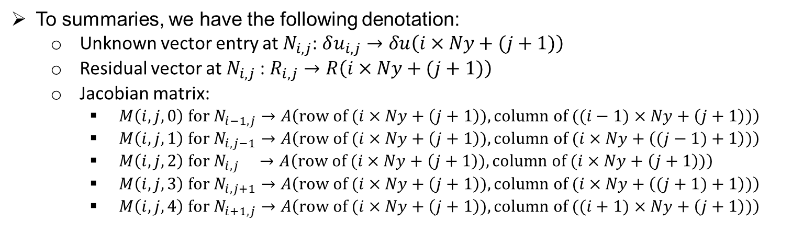
Denotation for sparse matrix (5)
We notice that there are a lot of zeros in the Jacobian matrix and residual vector:
$$\left[\begin{matrix}1 & 0 & 0 & 0 & 0 & 0 & 0 & 0 & 0 \\ 0 & 1 & 0 & 0 & 0 & 0 & 0 & 0 & 0 \\ 0 & 0 & 1 & 0 & 0 & 0 & 0 & 0 & 0 \\ 0 & 0 & 0 & 1 & 0 & 0 & 0 & 0 & 0 \\ 0 & \frac{1}{Δx^{2}} & 0 & \frac{1}{Δy^{2}} & −\frac{2}{Δx^{2}}−\frac{2}{Δy^{2}} & \frac{1}{Δy^{2}} & 0 & \frac{1}{Δx^{2}} & 0 \\ 0 & 0 & 0 & 0 & 0 & 1 & 0 & 0 & 0 \\ 0 & 0 & 0 & 0 & 0 & 0 & 1 & 0 & 0 \\ 0 & 0 & 0 & 0 & 0 & 0 & 0 & 1 & 0 \\ 0 & 0 & 0 & 0 & 0 & 0 & 0 & 0 & 1\end{matrix}\right]\left[\begin{matrix}\begin{matrix}\begin{matrix}\begin{matrix}δu_{0,0} \\ δu_{0,1} \\ δu_{0,2}\end{matrix} \\ δu_{1,0} \\ δu_{1,1}\end{matrix} \\ δu_{1,2} \\ δu_{2,0}\end{matrix} \\ δu_{2,1} \\ δu_{2,2}\end{matrix}\right]=−\left[\begin{matrix}\begin{matrix}\begin{matrix}\begin{matrix}0 \\ 0 \\ 0\end{matrix} \\ 0 \\ \left(\frac{u_{0,1}−2u_{1,1}+u_{2,1}}{Δx^{2}}+\frac{u_{1,0}−2u_{1,1}+u_{1,2}}{Δy^{2}}\right)\end{matrix} \\ 0 \\ 0\end{matrix} \\ 0 \\ 0\end{matrix}\right]$$
Unknown vector $δu$
Jacobian matrix $A$
Residual vector $−R$
To summaries, we have the following denotation:
Unknown vector entry at $N_{i,j}$: $δu_{i,j}→δu\left(i×Ny+(j+1)\right)$
Residual vector at $N_{i,j}$: $R_{i,j}→R\left(i×Ny+(j+1)\right)$
Jacobian matrix:
$M\left(i,j,0\right) for{ N}_{i−1,j}→A\left(row of (i×Ny+\left(j+1\right)),column of ((i−1)×Ny+\left(j+1\right))\right)$
$M\left(i,j,1\right) for{ N}_{i,j−1}→A\left(row of (i×Ny+\left(j+1\right)),column of (i×Ny+\left((j−1)+1\right))\right)$
$M\left(i,j,2\right) for{ N}_{i,j} →A\left(row of (i×Ny+\left(j+1\right)),column of (i×Ny+\left(j+1\right))\right)$
$M\left(i,j,3\right) for{ N}_{i,j+1}→A\left(row of (i×Ny+\left(j+1\right)),column of (i×Ny+\left((j+1)+1\right))\right)$
$M\left(i,j,4\right) for{ N}_{i+1,j}→A\left(row of (i×Ny+\left(j+1\right)),column of ((i+1)×Ny+\left(j+1\right))\right)$

Slide 16
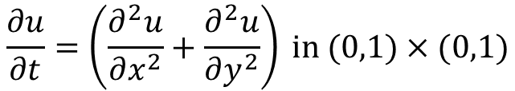
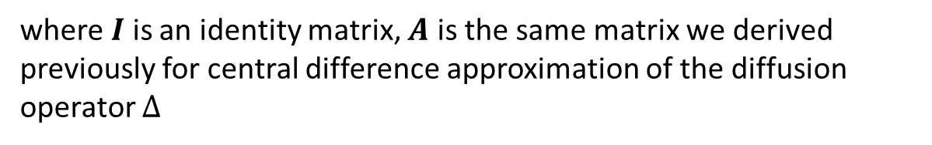


Transient heat transfer problem: Definition
The governing equation of the problem is:
$$\frac{∂u}{∂t}=\left(\frac{∂^{2}u}{∂x^{2}}+\frac{∂^{2}u}{∂y^{2}}\right) in (0,1)×(0,1)$$
We take a manufactured solution which satisfies the above equation:
$$u\left(x,y,0\right)=−exp⁡(−100(x^{2}+y^{2}))$$
Consider the Trapezoidal rule for temporal discretization:
$$\frac{I}{Δt}\left(u^{n+1}−u^{n}\right)=0.5Au^{n+1}+0.5Au^{n}$$
where $I$ is an identity matrix, $A$ is the same matrix we derived previously for central difference approximation of the diffusion operator $Δ$
Notes:
First, let me introduce the context of my research topic. The current research topic is motivated by the intelligent and green marine vessel proposal. We focus on the development of tools which make the marine vessels intelligent and environmentally friendly. Combining the high-fidelity model-based simulation and data driven techniques, we want to make the design and operation of the next generation marine vessels more interactive, automized, efficient and green. My focus is to reduce the noise of the ship and its harm to the marine mammals. This requires high fidelity simulation of multiphase fluid structure interaction.

Slide 17

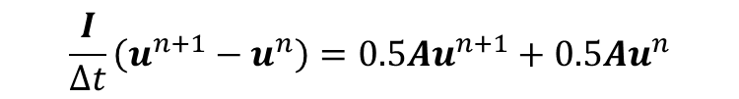


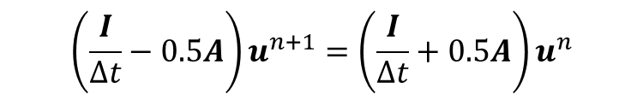
Newton-Raphson iteration(1)
Given the governing equation, we want to solve $u^{n+1}$:
$$\frac{I}{Δt}\left(u^{n+1}−u^{n}\right)=0.5Au^{n+1}+0.5Au^{n}$$
Rearrange the equation:
$$\left(\frac{I}{Δt}−0.5A\right)u^{n+1}=\left(\frac{I}{Δt}+0.5A\right)u^{n}$$
With known value of $u^{n}$, we denote $b=\left(\frac{I}{Δt}+0.5A\right)u^{n}.$
Therefore we have:
$$\left(\frac{I}{Δt}−0.5A\right)u^{n+1}=b$$
Rewrite this with Newton-Raphson iteration:
$$\left(\frac{I}{Δt}−0.5A\right){(u}_{k}^{n+1}+δu_{k}^{n+1 })=b$$
where $k$ denotes the number of iterations.

Slide 18

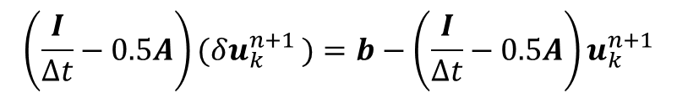


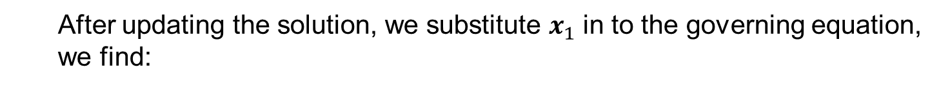
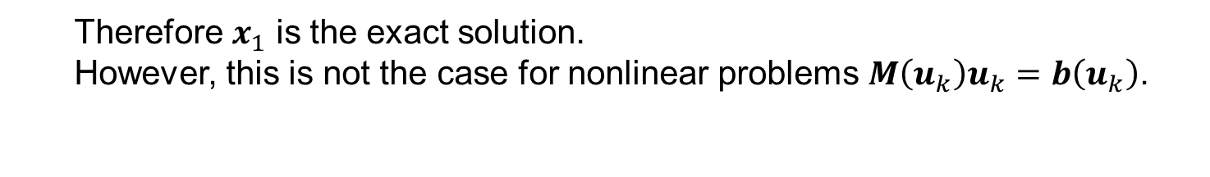


Newton-Raphson iteration (2)
As derived in the last page:
$$\left(\frac{I}{Δt}−0.5A\right){(u}_{k}^{n+1}+δu_{k}^{n+1 })=b$$
The update can be calculated as:
$$\left(\frac{I}{Δt}−0.5A\right)(δu_{k}^{n+1 })=b−\left(\frac{I}{Δt}−0.5A\right)u_{k}^{n+1}$$
For linear problem, the solution converges in one single iteration. This can be derived as follows:
$$M(x_{0}+δx_{0})=b$$
$δx_{0}=M^{−1}b−x_{0}$
$x_{1}=$ $x_{0}+δx_{0}=M^{−1}b$
After updating the solution, we substitute $x_{1}$ in to the governing equation, we find:
$$Mx_{1}=MM^{−1}b=b$$
Therefore $x_{1}$ is the exact solution.
However, this is not the case for nonlinear problems $M\left(u_{k}\right)u_{k}=b\left(u_{k}\right)$.

Slide 19
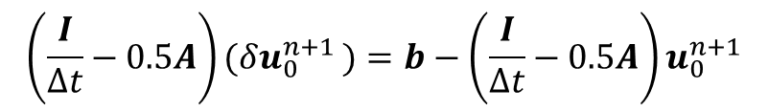

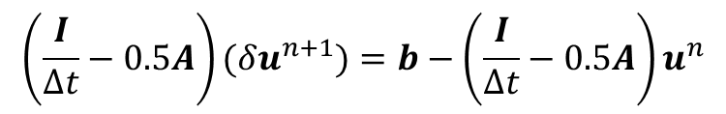
Newton-Raphson iteration (3)
With the convergence in one iteration, we have:
Initial guess as solution at previous time step: $u_{0}^{n+1 }=u^{n}$
Ture solution after one iteration: $u_{1}^{n+1 }=u_{0}^{n+1 }+δu_{0}^{n+1 }=u^{n+1}$
Substitute into the first iteration:
$$\left(\frac{I}{Δt}−0.5A\right)(δu_{0}^{n+1 })=b−\left(\frac{I}{Δt}−0.5A\right)u_{0}^{n+1}$$
We get:
$$\left(\frac{I}{Δt}−0.5A\right)(δu^{n+1})=b−\left(\frac{I}{Δt}−0.5A\right)u^{n}$$
$$u^{n+1}=u^{n}+δu^{n+1}$$
Substituting $b=\left(\frac{I}{Δt}+0.5A\right)u^{n}$,we finally get the linear matrix form:
$$\left(\frac{I}{Δt}−0.5A\right)(δu^{n+1})=Au^{n}$$

Slide 20

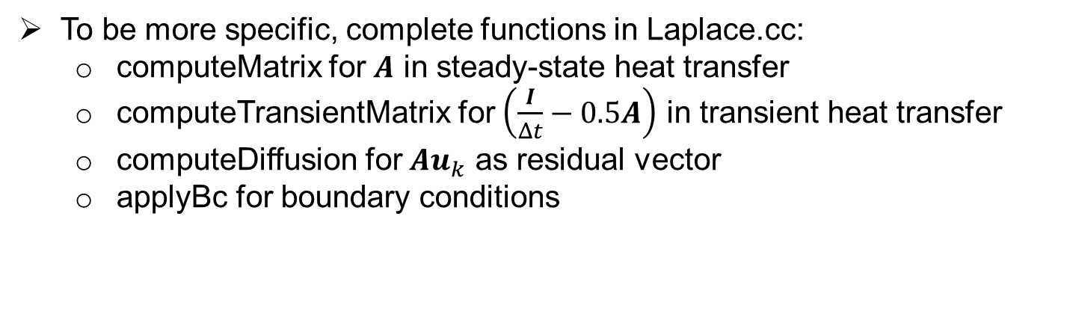
Your tasks
To summarize, the linear systems we need to solve are:
Steady-state heat transfer
Transient heat transfer
$$A δu_{k}=−Au_{k}, u_{k+1}=u_{k}+δu_{k}$$
$$\left(\frac{I}{Δt}−0.5A\right)\left(δu^{n+1}\right)=Au^{n}, u^{n+1}=u^{n}+δu^{n+1}$$
The matrices and vectors in the red boxes are to be formed in the code
In the code, the matrices and vectors are initialized as random values. You need to change them to correct values.
To be more specific, complete functions in Laplace.cc:
computeMatrix for $A$ in steady-state heat transfer
computeTransientMatrix for $\left(\frac{I}{Δt}−0.5A\right)$ in transient heat transfer
computeDiffusion for $Au_{k}$ as residual vector
applyBc for boundary conditions

Slide 21




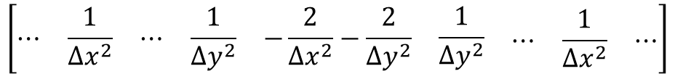






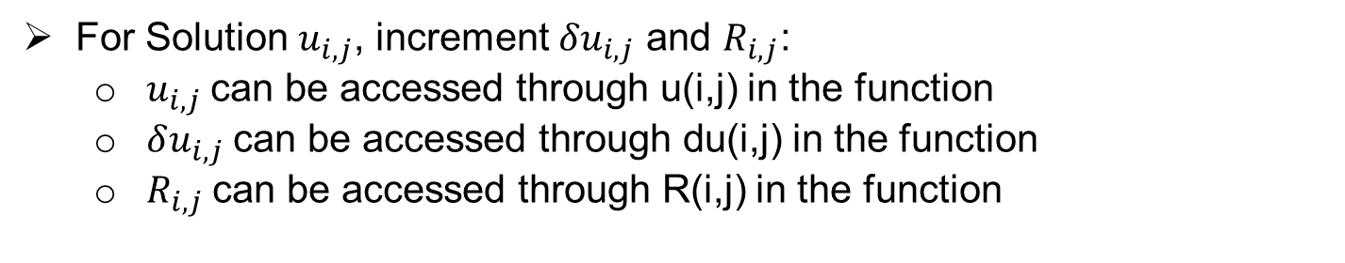
On assigning values to matrices and vectors
Taking steady-state heat transfer problem as an example:
For row of matrices $A$ corresponding to point $u_{i,j}$ :
$$\frac{δu_{0,1}−2δu_{1,1}+δu_{2,1}}{Δx^{2}}+\frac{δu_{1,0}−2δu_{1,1}+δu_{1,2}}{Δy^{2}}$$
Formulation:
$$\left[\begin{matrix}⋯ & \frac{1}{Δx^{2}} & \begin{matrix}⋯ & \frac{1}{Δy^{2}} & \begin{matrix}−\frac{2}{Δx^{2}}−\frac{2}{Δy^{2}} & \begin{matrix}\frac{1}{Δy^{2}} & \begin{matrix}⋯ & \frac{1}{Δx^{2}} & ⋯\end{matrix}\end{matrix}\end{matrix}\end{matrix}\end{matrix}\right]$$
Coefficients:
Corresponding Variables:
$${δu}_{i−1,j}$$
$${δu}_{i,j−1}$$
$$δu_{i,j}$$
$${δu}_{i,j+1}$$
$${δu}_{i+1,j}$$
Coefficients can be accessed:
$$M\left(i,j,0\right)$$
$$M(i,j,1)$$
$$M(i,j,2)$$
$$M(i,j,3)$$
$$M(i,j,4)$$
For Solution $u_{i,j}$, increment ${δu}_{i,j}$ and $R_{i,j}$:
$u_{i,j}$ can be accessed through u(i,j) in the function
$δu_{i,j}$ can be accessed through du(i,j) in the function
$R_{i,j}$ can be accessed through R(i,j) in the function

Slide 22
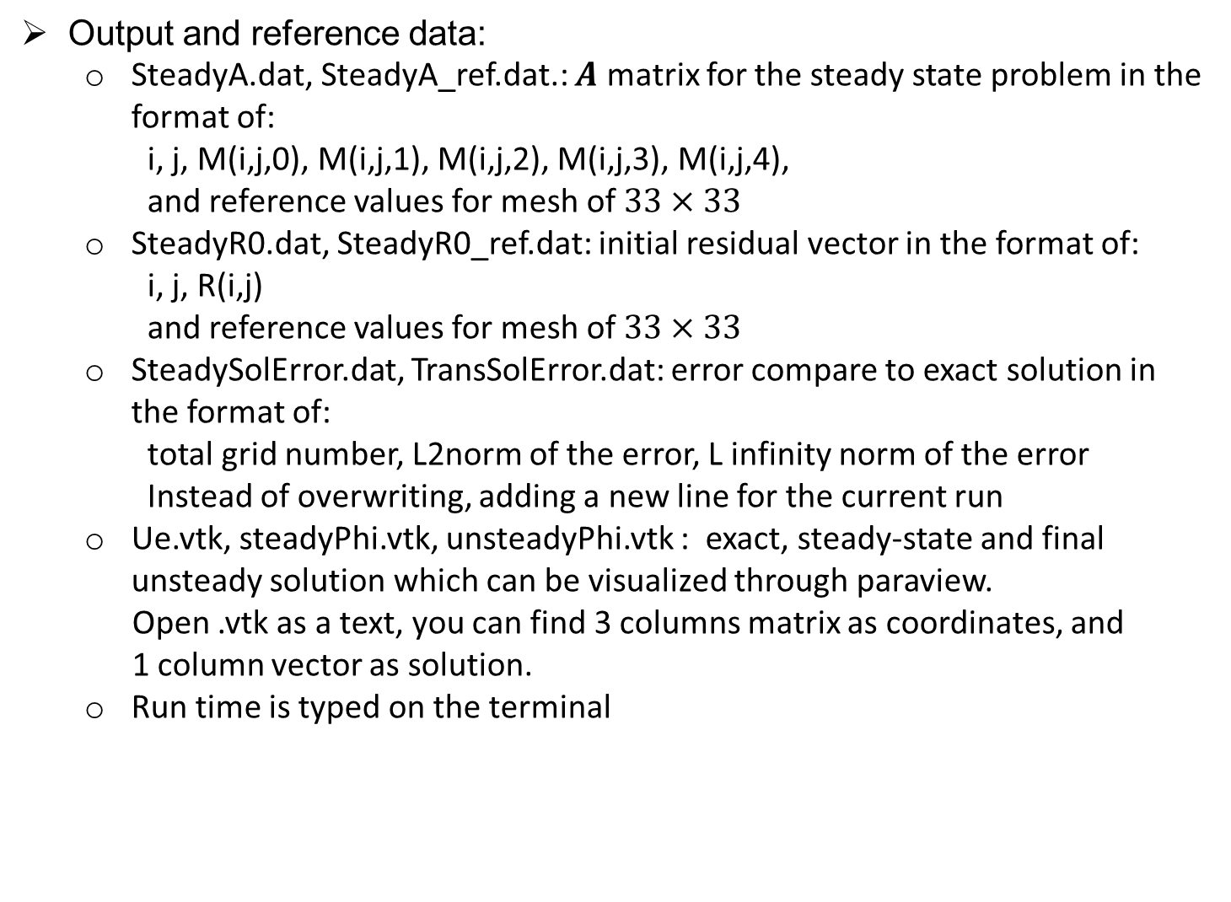
Files in the code
Input: Laplace.in contains 3 numbers of: Nx, Ny, dt
Source code: Base.h, Base.cc, Laplace.cc
Output and reference data:
SteadyA.dat, SteadyA_ref.dat.: $A$ matrix for the steady state problem in the format of:
i, j, M(i,j,0), M(i,j,1), M(i,j,2), M(i,j,3), M(i,j,4),
and reference values for mesh of $33×33$
SteadyR0.dat, SteadyR0_ref.dat: initial residual vector in the format of:
i, j, R(i,j)
and reference values for mesh of $33×33$
SteadySolError.dat, TransSolError.dat: error compare to exact solution in the format of:
total grid number, L2norm of the error, L infinity norm of the error
Instead of overwriting, adding a new line for the current run
Ue.vtk, steadyPhi.vtk, unsteadyPhi.vtk : exact, steady-state and final unsteady solution which can be visualized through paraview.
Open .vtk as a text, you can find 3 columns matrix as coordinates, and
1 column vector as solution.
Run time is typed on the terminal

